Slide 1
Building Generational Wealth
Presented by the IN/KY Mortgage Banker’s Association Future Leaders

Slide 3
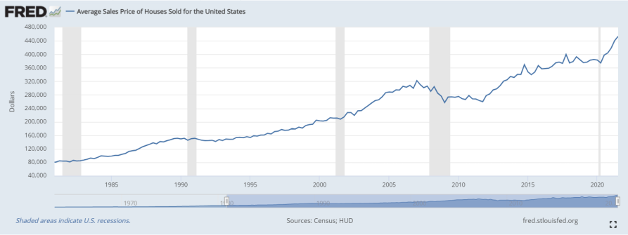
What is “Generational Wealth?”
Generational wealth refers to any kind of asset that families pass down to their children or grandchildren. (cnbc.com/select/what-is-generational-wealth/)
It’s about compound interest. What you start today has the ability to grow exponentially.
It isn’t just money!
Property
Life Insurance
Stocks
Education
Culture/Work Ethic
Stability and Generational Wealth
Invest/start a small business
Future generations have more spending money without rent, more collateral for loans
Home Ownership
Plant the seed today for a better tomorrow.

Slide 4
INKY MBA Initiative – What Our Lenders are Doing to aid with bridging the gap…
As a part of our group project we have reached out to see what IN and KY lenders within the MBA are doing to help close the generational wealth gap within our target demographic. We asked the following questions:
Do you have loan originators that specialize in assisting first-time home-buyers that typically require more attention, guidance and communication?
We received mixed responses of “Yes, absolutely,” “Yes, some,” and “Not Really.”
What tools and training are you providing for credit uplifting that is not just the potential borrower paying off debt up front?
Each lender who responded has partnerships with vendors or partner with housing to assist with this.

Slide 5
INKY MBA Initiative – What Our Lenders are Doing continued….
How does your company market to minority groups, especially when there is a language barrier?
We received mixed responses as to what is being done to target these groups. We have lenders who are working on initiatives to have something in place. While there are some that are already active in ensuring this demographic is being served.
Do you offer homeownership courses/counseling for individuals who do not qualify for a mortgage?
All lenders who responded offer services to help these groups work towards their goal of attaining homeownership either via referring them to counseling agencies or working with them direct.
BUT… Could we be doing MORE ???

Slide 6
INKY MBA Initiative – What Can We Do?
Take on an initiave to dispel the myths by means of social media takeover that markets and speaks to our core demographic.
Take advantage and promote Indiana Housing and Kentucky Housing Corporation (KHC) programs to our customers.
IN/KY Habitat for Humanity
Get involved in the community; participate in a local build.
Presentations in local high schools
Include in high school curriculum → Potentially work with state to have added.
Maybe have a presentation in the evening in an auditorium to encompass a broader range of people.
Set up a referral system, complete with points of contact (POCs) with member lenders who have applicable loan programs in place.
Create a page on the MBA websites geared toward the consumers; include links to resources and / or participating lenders.

Slide 7
Mythbusting
What are the top 3 things deterring this population from home ownership?
Down Payment
Debt-to-Income (DTI)
Credit Score

Slide 8
Common Myths About Homeownership
Myth: Don’t I need a large down payment saved before I can buy a home?
Fact: No, there are many mortgage options with little to no down payment if you qualify.
Myth: Doesn’t my credit have to be perfect?
Fact: No, perfection is not a requirement, however an established responsible credit history is important. Financial Institutions/Lenders can offer programs pending credit ranges.

Slide 9
Common Myths About Homeownership (Cont.)
Myth: I cannot buy a home while I have student loan obligations, right?
Fact: No, fact is that student loan obligations can be included in the qualifying process.
Myth: I cannot buy a home on my own. Isn’t it an automatic requirement that I have someone else on the loan with me?
Fact: No, that is not an automatic requirement. A qualifying Individual can obtain a mortgage loan on their own.
Myth: Applying for a mortgage is too complicated.
Fact: Not at all, there are Financial Institutions/Lenders that will walk you through a step by step process as well as offering Homebuyer Education Courses.

Slide 10
Social Media Initiative
Kentucky Housing Corporation (KHC) has staggering information to support why one initiative we need to combat is social media presence and speaking to younger generations. The following slides will address this information as it was obtained by KHC.
Opportunities for us to continue the work
Social media presence, to be a top source in these communities for Homeownership information. Reaching the younger generation to educate about money.
The KHC report indicates youth learning about money at a young age correlates with:
Having an emergency fund, contributing to savings, contributing to investments and HSA’s as well as education savings and $500/mo or more to savings and investments.
What is NextGen (GenZ & Millennials) Buyers saying about home ownership ?
Who influences this generation ?
Platforms used weekly : 9 of 10 check Facebook and 7 of 10 check Instagram and YouTube
97.5 % They turn to online resources- they do not go to real estate professionals
This is scary considering the amount of misinformation that can be found online and the lack of use of professionals is very concerning

Slide 11
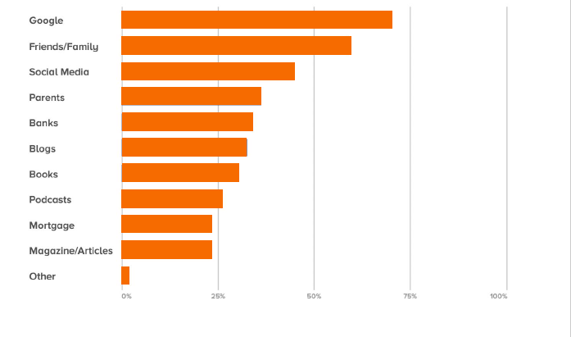
Social Media Initiative
Infographic on where people are going to obtain personal finance information. Generations are not looking to industry leaders for information primarily.

Slide 12
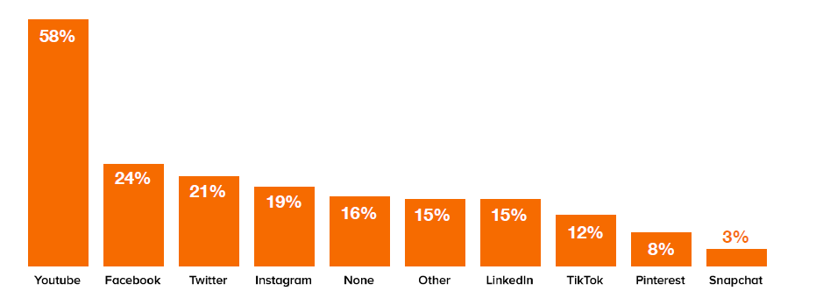
Social Media Initiative
What social media platforms are being used ?

Slide 13
Social Media Initiative
Hurdles
Quality of Experience or trustworthiness of lenders
52% of buyers have reported good experiences with loan officers
1 in 3 feel as if lenders are reliable or trustworthy… Let that sink in 1 of 3.
Homeownership
Homeownership ranks 3rd amongst financial priorities under savings and children
Investment :1/5 say their biggest challenge is whether the home is a good investment.
Education : ¼ say their biggest challenge while buying a home was lack of understanding
7/10 are saving less than $500/mo
64% view credit card and student loans as a hurdle
7/10 respondents have consumer debt
77% of respondents have less than 20k in consumer debt including student loans
Budgeting and financial planning
75% of men grew up learning to budget and financial plan vs women 60%
Investment Gaps
Men are more 3 times more likely to contribute to investing than women

Slide 14
Social Media initiative and reaching out to younger generations
Infographics on popular statements
I need to have 20% for home down payment.
I need to be a W-2 employee and work a traditional job.

Slide 15
Social Media initiative and reaching out to younger generations
Infographics on popular statements
Student Loan debt or car loans will prevent me from qualifying for a mortgage

Slide 16
Call to action for Social Media Presence and proposal
Because of the growing number of Milliennials and GenZ homebuyers getting their information online, the MBA needs to establish a presence in various social media outlets.
Facebook – Educational posts, “town hall” meetings, etc.
TikTok – Fun, short, informational video clips.
Videos can be shared across other social media outlets
Instagram – Posts can easily be shared from Facebook and other social media outlets.
https://www.tiktok.com/t/ZM87kuR6g/

Slide 17
Promoting Current Programs as options in our communities
Kentucky Housing Corporation (KHC)
Indiana Housing and Community Development Authority (IHCDA)

Slide 18
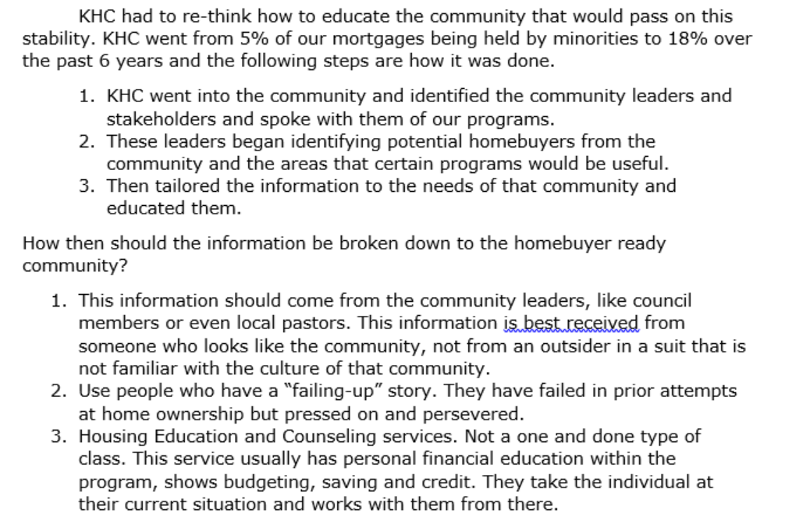
Kentucky Housing Corp

Slide 19
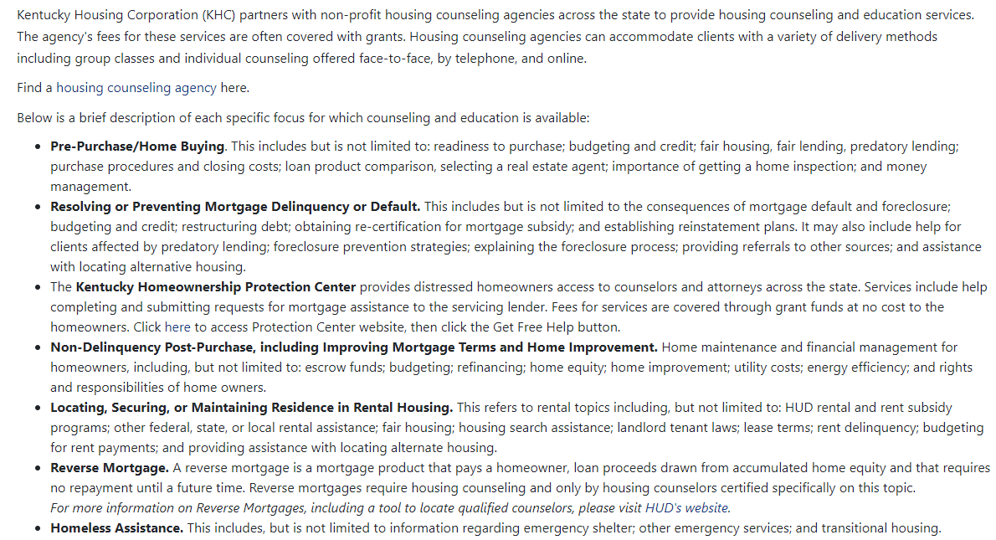
Kentucky Housing Corporation (KHC)

Slide 20
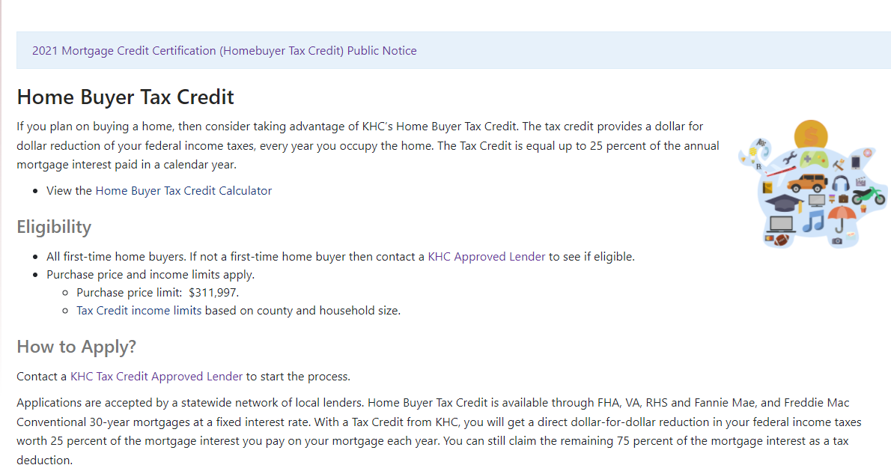
Kentucky Housing Corp

Slide 21
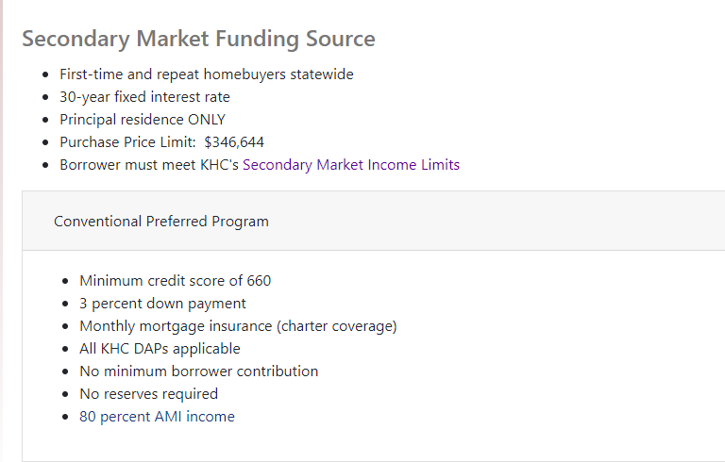
Kentucky Housing Corp

Slide 22
Kentucky Housing Corp
MCC Income Limits and Eligibility
Loan Programs : VA, FHA, RHS, Preferred and Preferred Plus Conventional loans.
Finding a qualified lender.
Down Payment Assistance
Eligibility
All can be found at www.kyhousing.org/homeownership

Slide 23
Indiana Housing and Community Development Authority (IHCDA)
“IHCDA's work is done in partnership with developers, lenders, investors, and nonprofit organizations that use our financing to serve low- and moderate-income Hoosiers. We leverage government and private funds to invest in financially sound, well-designed projects that will benefit communities for many years to come. And our investments bear outstanding returns. The activities that we finance help families become more stable, put down roots and climb the economic ladder. In turn, communities grow and prosper, broadening their tax base, creating new jobs, and maximizing local resources. IHCDA's work is truly a vehicle for economic growth, and it all starts at home.”
Key Words and Phrases: Down Payment Assistance (DPA): A second mortgage but carries no interest and no payments as long the borrower(s) adhere to the Affordability Period guidelines Affordability Period: “If the Borrower uses the Property as his or her primary residence throughout the Affordability Period through the End of the Affordability Period, the Loan will be forgiven. However, if the Borrower sells, refinances, fails to occupy, or abandons the Property throughout the End of the Affordability Period, the Borrower must repay to IHCDA the entire principal balance of the Loan.” First-Time Homebuyer: A first-time homebuyer is defined as someone who has not held ownership in their principal residence in the last 3 years.

Slide 24
IHCDA Programs - First Place
FHA 30 year Fixed Rate loan program
Purchase price may not exceed the appraised value
Down Payment Assistance in the amount of 6.0% of the purchase price
Affordability Period: Must maintain the home as owner occupied for 9 years from the closing date
Must be a first-time homebuyer unless the subject property is in a qualified census tract or targeted area.
Minimum Credit for debt to income less than 45%: 640
Minimum Credit for debt to income 45% to less than 50%: 680
First Place Program Guide

Slide 25
IHCDA Programs – Next Home
FHA 30-year Fixed Rate loan program
Purchase price may not exceed the appraised value
Down Payment Assistance in the amount of 3.5% of the purchase price
Affordability Period: Must maintain the home as owner occupied for 3 years from the closing date
Minimum Credit for debt to income less than 45%: 640
Minimum Credit for debt to income 45% to less than 50%: 680
Does not have to be a first-time homebuyer, unless the borrower is utilizing the Next Home FHA Program in conjunction with the MCC as a combo program
Next Home Program Guide

Slide 26
IHCDA Programs – Mortgage Credit Certificate (MCC)
Federal Income Tax Credit, which can assist the borrower(s) in reducing their federal income tax liability, and/or increasing their qualifying income.
Must be a first-time homebuyer, unless the subject property is located in a qualified census tract or targeted area, or the borrower is a qualified veteran.
Can be combined with the Next Home Program.
MCC Program Guide

Slide 27
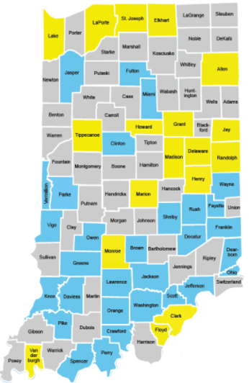
Targeted Areas - Indiana
Key:
Yellow Counties are a “qualified census tract”, where 70% or more families have an income which is 80% or less of the statewide median family income.
Blue Counties are areas of chronic economic distress, which are designated by the State and approved by the federal government as “targeted” for additional public/private investment.
Additional Resources:
IHCDA Website Participating Lenders
Down Payment Assistance Explanation
How to get started with the home buying process
Targeted Areas
Definition of a "Targeted Area"

Slide 28
Questions??

Slide 29
Links to Additional Resources
National MBA’s Building Generational Wealth: https://www.mba.org/advocacy-and-policy/general-policy-issues/building-generational-wealth-through-homeownership [mba.org]
FDICs Money Smart for Adults: https://www.fdic.gov/resources/consumers/money-smart/teach-money-smart/money-smart-for-adults.html
Testimonial Video: Downpayment Assistance - Loretta (vimeo.com)
NextGen Homebuyer Report 2021 Slide Deck: 2021 NextGen Homebuyer Report - Google Slides
NextGen Homebuyer FULL Report: COS565_2021NextGenHomebuyerReport_R3V1-09-29-21_Digital.pdf (squarespace.com)

