Slide 1
Communication improvements
KentuckY and Indiana mortgage bankers associations

Slide 2
Improving Facebook Presence
IMBA
MBAK
Update the “About” Content
  Add a phone #
  Include hours of operation
  Add an email address to the contact information
Post more frequently about upcoming events
Add an “About” section
  Tell about the organization
  Include a FAQ section
  Add a phone #
Post more frequently about upcoming events
  Try to have a minimum of 2 posts a month

Slide 3
YouTube
Ways to Improve
https://www.youtube.com/channel/UCVJHYBxhlqBOx606NNyaNAw
There are not many views on the videos available
  Need to advertise more so people know the channel is available. Use other social media platforms such as Facebook or LinkedIn to get the word out
  Get people to subscribe
We need to be consistent and post more videos
  Can we record and post the presentations received in our modules?
  Offer monthly videos with updates on changes, upcoming events, etc.
We need to interact more when videos are posted
  Make comments on videos
  Respond to other people's comments

Slide 4
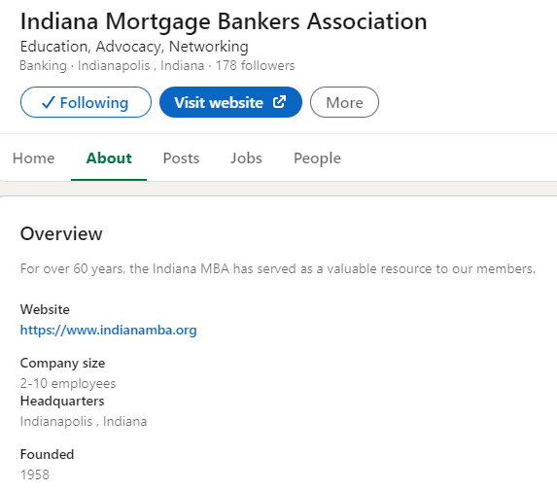
Linkedin
Increase content
  Add upcoming events
  Recent industry news
  Post once a month at the least
  Perhaps add a short blog relating news content in a conversational manner (more casual, less formal)
More focus on the members
  Who are they & why would I want to join?
  Needs personal touch – similar to the board related posts for fun occurrences
Update “About” section of new page
  What valuable resources do you offer: education, advocacy, and networking
Open up the group to the public to gain more followers and interest
  Include other Social Media links on the page in a conspicuous space

Slide 5
Website – Contact Us/Find us on the Web
Currently, the “Contact Us” section of the website has the HQ address, office phone, and email. While this is sufficient information to contact the IMBA, we can bring it more up-to-date with our presence elsewhere on the internet and social media.
I propose an interactive contact us page – similar to some realtor’s websites – that gives the option to send emails directly to the ExecDir email address. This not only gives a cleaner look to the site, but also allows the leadership team to receive a form including contact information for anyone who requests information.
Additionally, on either the same contact page, or on the home landing page, we should add an RSS feed that is linked to all forms of social media. This accomplishes two things:
  Allows individuals who visit the page to keep up with current goings-on in the IMBA across Facebook, LinkedIn, and (possibly) Twitter.
  Shows the IMBA’s presence on all of these sites, and gives easy access – just a click away – to follow and interact with those pages to anyone who may not know that we can connect in those ways.
Making the website more streamlined and modernized in this way will help visitors to the page more easily access ways to get in touch with, and contact the IMBA.

Slide 6
Website Continued
Forums Section - Changing to a Blog Section may be better for the Indiana Website and add this to the Kentucky Website. I found the Blog Section on the California Website to be of interest. Their articles were once a month. The Forums section did not really have much participation whereas a blog article may prompt someone to read it like when I reviewed the CA Website
Consumer Information Section IN – Adding more links and descriptions for new programs/associations that would help with new home ownership. This may be able to be incorporated with a Helpful Links Tab (MBAKY Website) as shown in the next slide.
Career Information – Simplify or provide an employer section, similar to the California Website as shown in the next slide. This could also include perhaps a link to either add internships by employers or for students who may be interested in internships to add their contact details and information for employers to review.
This could be promoted on marketing to colleges and promoted to members and employers.
Add the MBA Diversity Equity and Inclusion to the IN Website – Believe this would be an addition to the website that is current in today’s environment.

Slide 7
Newsletter
Set up the Newsletter to have an online link for members to access.
Content – Pick an organization for the newsletter to highlight, for example Habitat for Humanity or INHP or the new MBA home program. This could be incorporated with the website/Facebook or other social media outlets. This could also be alternated with a current or historical fact about Indiana/Kentucky.

Slide 8
E-Mail Enhancements:
Current findings
Currently, the e-mails seem to be somewhat sporadic and do not offer the bountiful information found on the webpage as example.
There is an abundance of information on the website regarding upcoming events and even coverage of past events.
A huge opportunity is missed by not utilizing this communication as all mortgage people have and use e-mail daily.
This could be especially important to help capture the new people coming into the mortgage world.

Slide 9
E-Mail Enhancement:
Ideas
Create a weekly e-mail to all users.
Be sure the e-mail covers all upcoming events, including title of the event, dates, times, costs and give more time for people to be aware and pre-register. I think this will help grow the events as well.
Encourage all users who are managers to be sure to have their new employees sign up for the e-mails. Help create excitement and get them engaged early on in their career.
Use e-mail to include where to find information such as the direct website, Facebook, and LinkedIn, as examples.

